Slide 1
Master Thesis: Alzheimer Prediction
Fraj Yassine Lakhal
Munich, 3. December 2025
Notes:
I have a bold plan for the thesis but I think it is feasible

Slide 2
Motivation

Slide 3
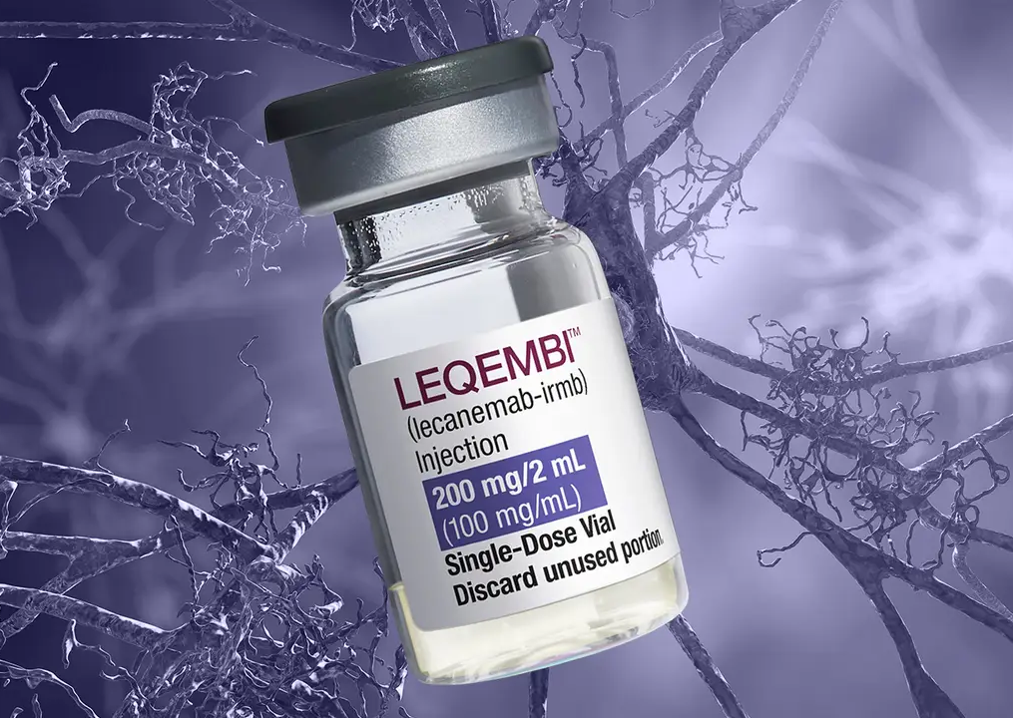
Alzheimer’s Disease Modifying treatment
Lecanemab approved for prescription on 15. April in Germany
Diagnosis is no longer just about memory tests; it now requires biological proof of Alzheimer's via biomarkers.
Approved for Early AD (Mild Cognitive Impairment or Mild Dementia)
It clears amyloid plaques to slow cognitive decline by ~27%. It does not restore lost memory; it preserves what is left.

Slide 4
Current Paradigm
1. Cognitive test: e.g., MOCA or MMSE
If you score below a certain threshold
(e.g., <26/30 on MOCA)
2. Blood test: Plasma p-tau217
radioactive tracer amyloid plaques
Highly suspicious for Alzheimer’s. The patient moves to the "Gold Standard" confirmation required for insurance and treatment approval.
3. Scans
Amyloid PET Scan: radioactive tracer amyloid plaques.
or
CSF Analysis (Lumbar Puncture): Spinal fluid is drawn to measure the ratio of amyloid/tau proteins.
Notes:
1) If you report memory issues, a Primary Care Physician (PCP) will perform a short cognitive test
2) How it works: It detects phosphorylated tau protein in the blood, which correlates 90-95% with amyloid plaque buildup in the brain.

Slide 5
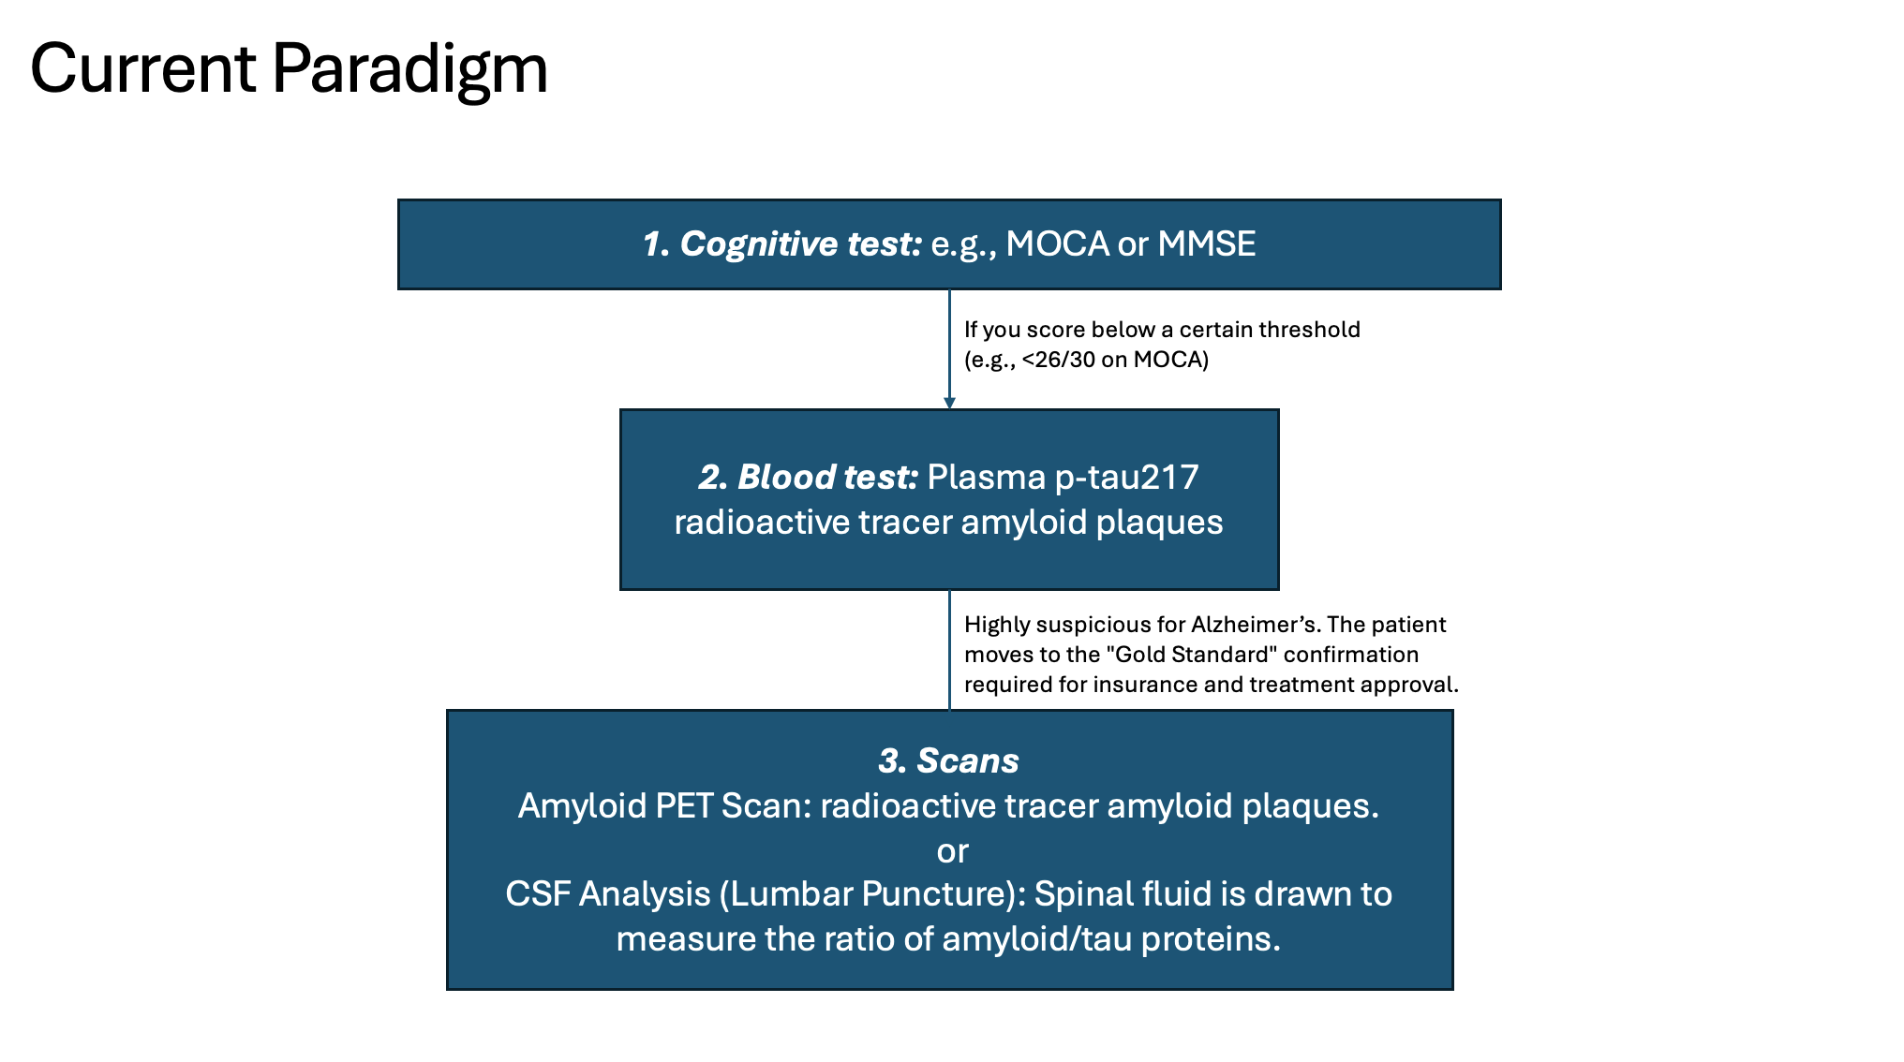
Several Issues: 1. Functional "Collapse" Precedes Structural Atrophy 2. Burdensome for elderly patients.

Slide 6
Several Issues: 1. Functional "Collapse" Precedes Structural Atrophy 2. Burdensome for elderly patients. Can we identify functionally vulnerable patients early on?

Slide 7
Why resting-state fMRI?
A. Detecting "Synaptic Failure" Before "Cell Death”
rs-fMRI detects functional connectivity breakdown. Often, synapses usually fail before neurons die.
B. Safety (Radiation)
Amyloid PET scans expose patients to radiation (~3–7 mSv, equivalent/more to a year of natural background radiation).
C. Scalability
. PET: $2,300 to over $9,5001 + Rare in rural areas (radioactive tracers' availability)
rs-fMRI: <$8003 has zero radiation.
1 https://www.carecredit.com/well-u/health-wellness/pet-scan-cost/#:~:text=Depending%20on%20the%20specific%20type%20of%20procedure,range%20between%20$1711%20and%20$12848.%20Learn%20more.
2 Young P, Heeman F, Axelsson J, Collij LE, Hitzel A, Sanaat A, Niñerola-Baizan A, Perissinotti A, Lubberink M, Frisoni GB, Zaidi H, Barkhof F, Farrar G, Baker S, Gispert JD, Garibotto V, Rieckmann A, Schöll M; AMYPAD
consortium. Impact of simulated reduced injected dose on the assessment of amyloid PET scans. Eur J Nucl Med Mol Imaging. 2024 Feb;51(3):734-748. doi: 10.1007/s00259-023-06481-0. Epub 2023 Oct 28.
PMID: 37897616; PMCID: PMC10796642.
3 https://www.mdsave.com/procedures/functional-mri-fmri/d584f5cc
Notes:
A. Deep Learning’s Role: A human radiologist cannot "see" functional connectivity in raw data. A DL model (e.g., a Graph Neural Network or 4D-CNN) can identify non-linear disruptions in the Default Mode Network (DMN)—specifically the uncoupling between the Posterior Cingulate Cortex (PCC) and the hippocampus—often years before atrophy is visible on T1 scans.

Slide 8
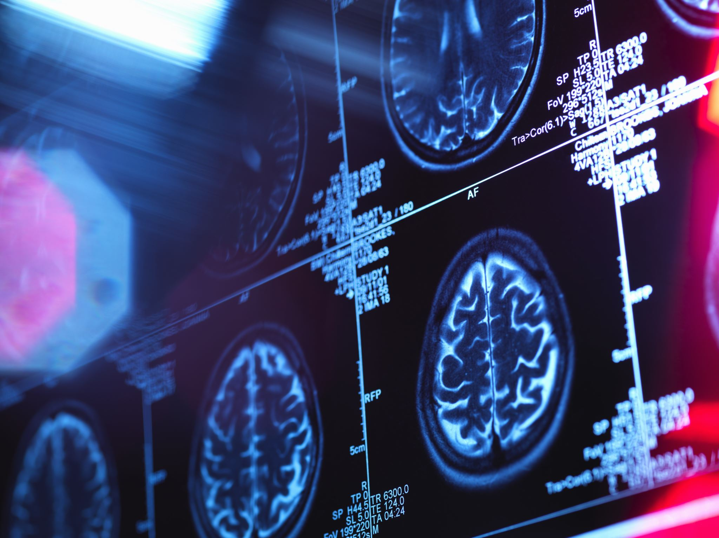
Why combine with deep learning?
A human radiologist cannot "see" functional connectivity in raw data.
A DL model (e.g., a Graph Neural Network) can identify non-linear disruptions in the Default Mode Network (DMN), often years before atrophy is visible on T1 scans1.
1 Xue, C., Yuan, B., Yue, Y., Xu, J., Wang, S., Wu, M., Ji, N., Zhou, X., Zhao, Y., Rao, J., Yang, W., Xiao, C., & Chen, J. (2019). Distinct Disruptive Patterns of Default Mode Subnetwork Connectivity Across the Spectrum of Preclinical Alzheimer’s Disease. Frontiers in Aging Neuroscience, 11. https://doi.org/10.3389/fnagi.2019.00307
Notes:
DMN stands for active regions when a person is not focused on the outside world

Slide 9
SoTA

Slide 10
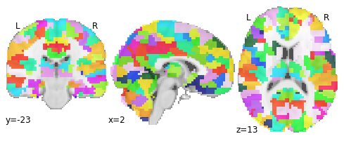
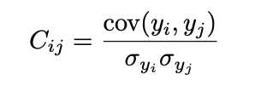
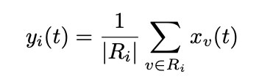

Usual Workflow for fMRI Preprocessing
1. ATLAS Parcellation
e.g. Harvard Oxford
2. Compute mean at time t
3. Pearson Correlation
Notes:
We end up with a symmetric N×N matrix where N is the number of ROIs

Slide 11
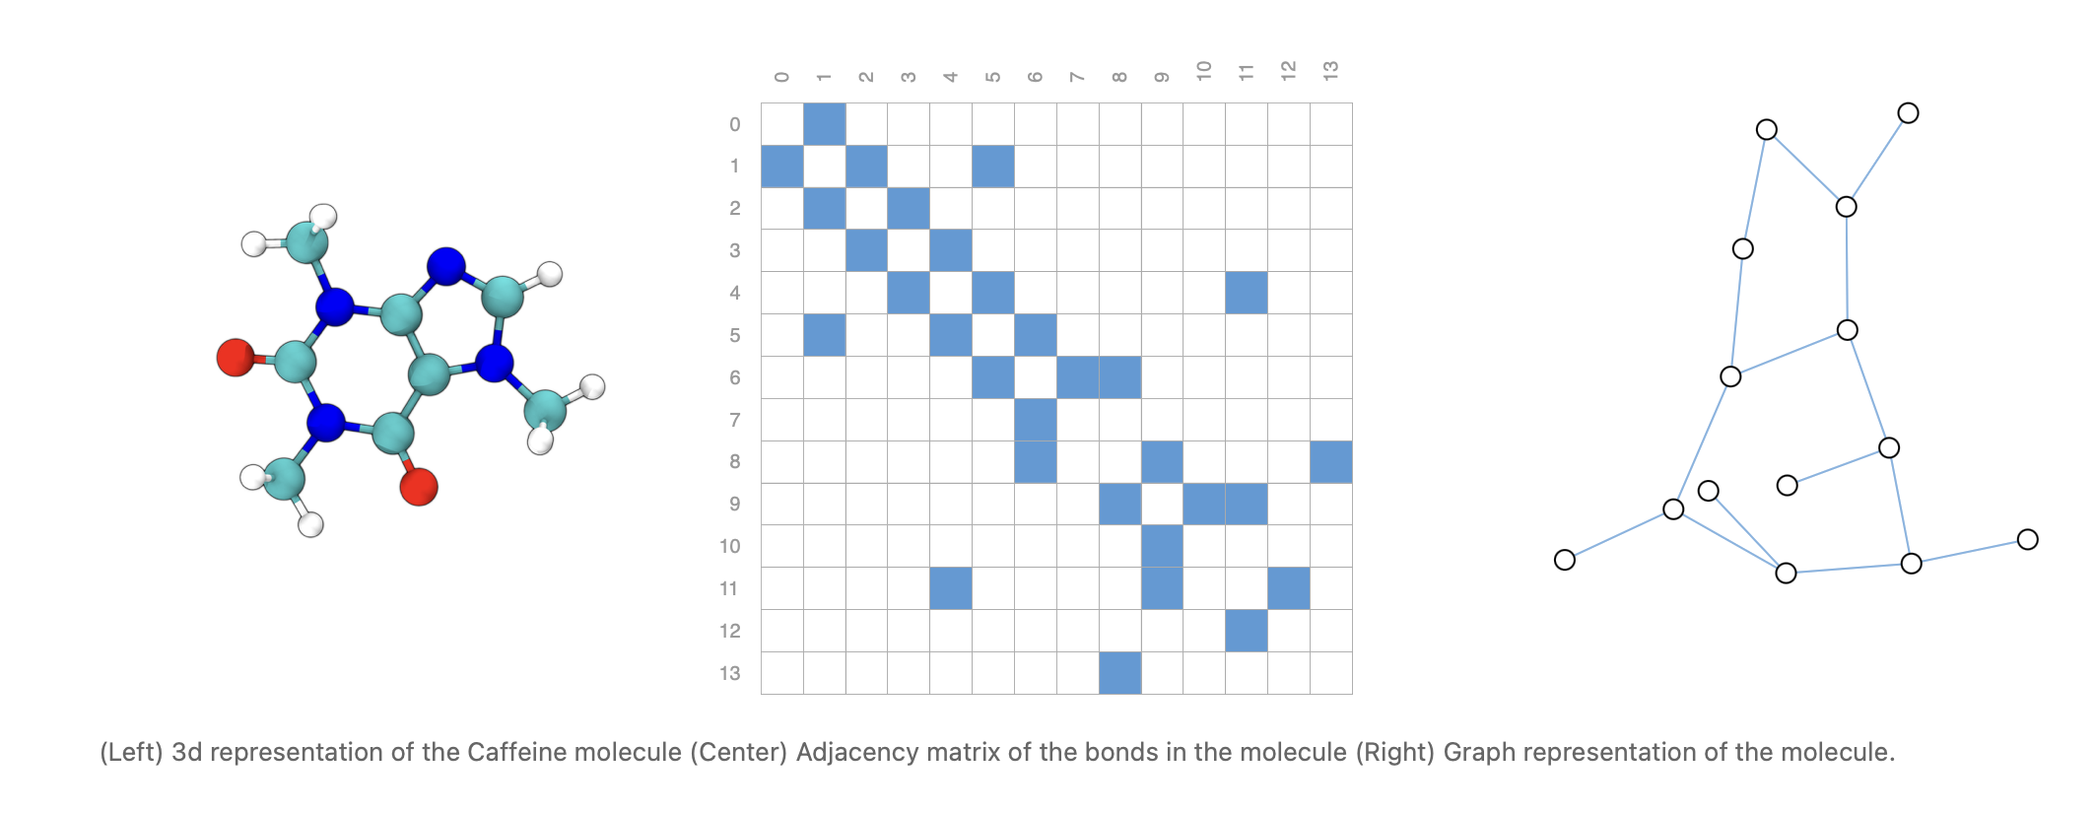
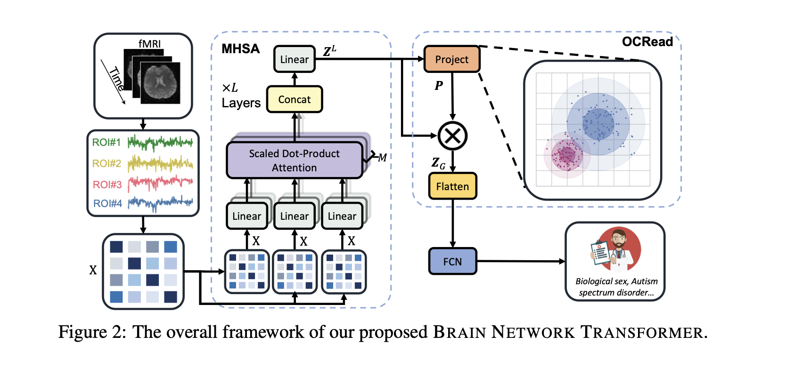
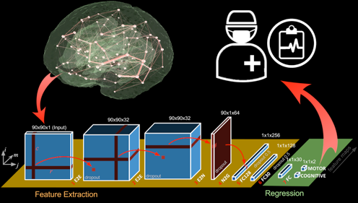
DL Frameworks (Related Work)
Graph Neural Networks
(e.g. GAAE)
Transformers
CNNs
Notes:
I can send you a list of the related work

Slide 12
Proposal

Slide 13
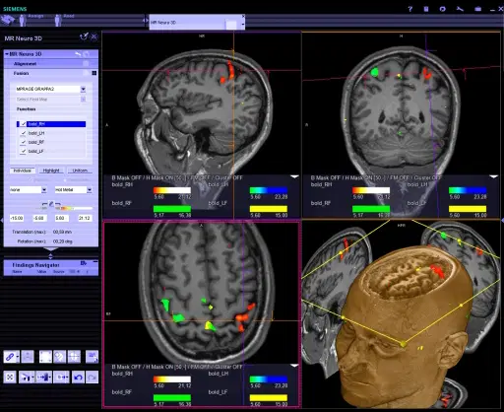
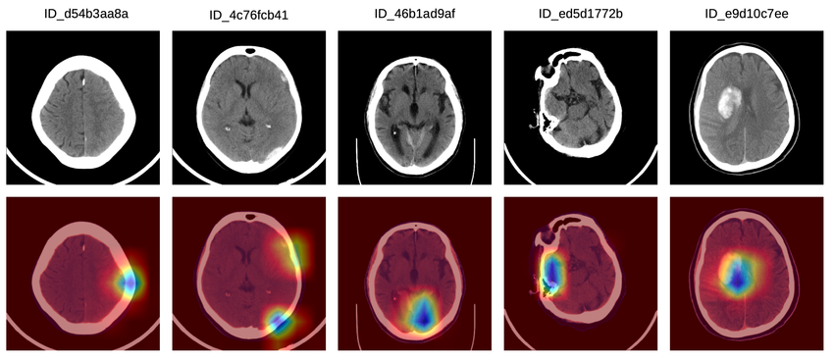
My Proposal
A platform for diagnosis: from 4D fMRI Scans to xAI Diagnosis
Code free
Visualization (e.g. gradCAM) +
Detailed Diagnosis (e.g. clinical LLM)
Burduja, Mihail & Ionescu, Radu Tudor & Verga, Nicolae. (2020). Accurate and Efficient Intracranial Hemorrhage Detection and Subtype Classification in 3D CT Scans with Convolutional and Long Short-Term Memory Neural Networks. Sensors. 20. 10.3390/s20195611.
Notes:
As I don’t want my work to end up on a shelf, I want to propose a tool
Stephan mentioned that this could very interesting in

Slide 14
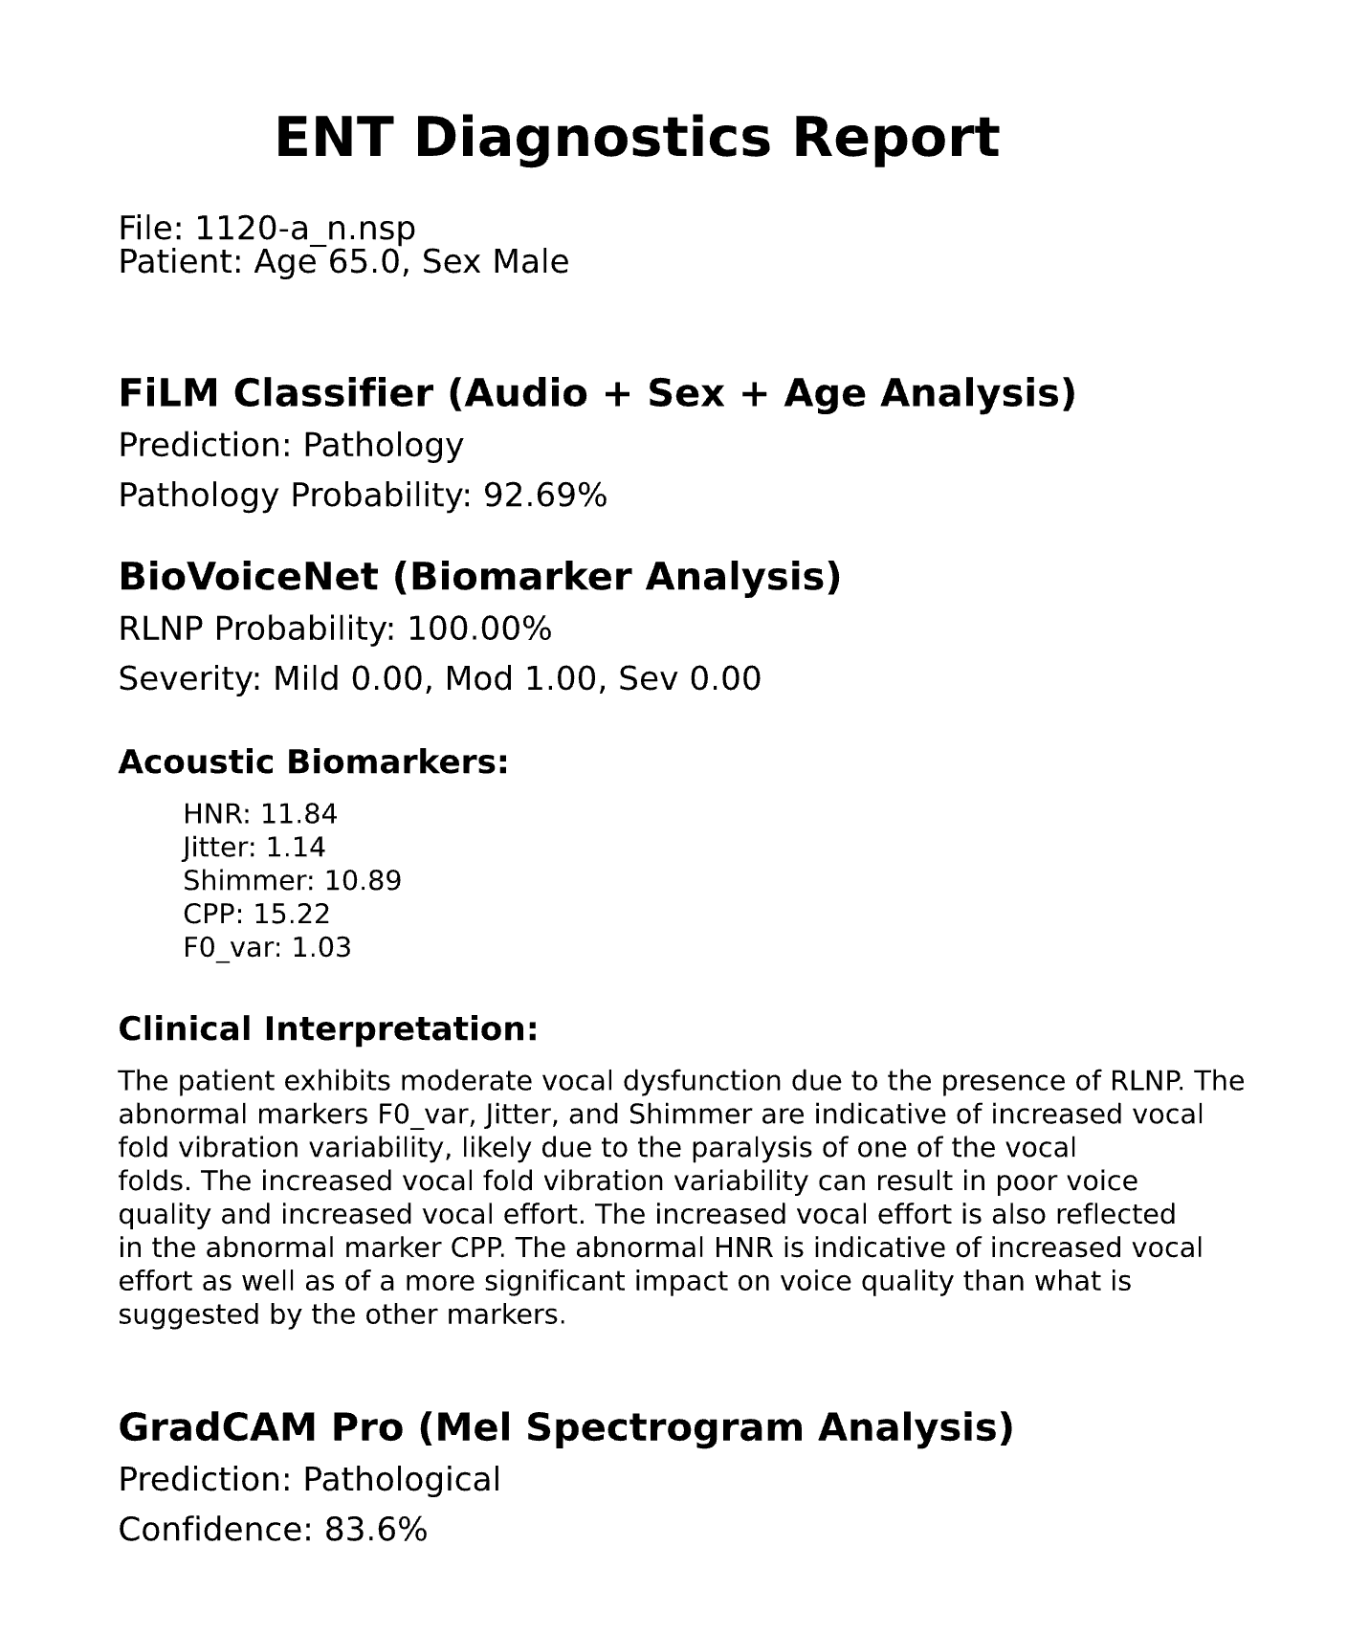
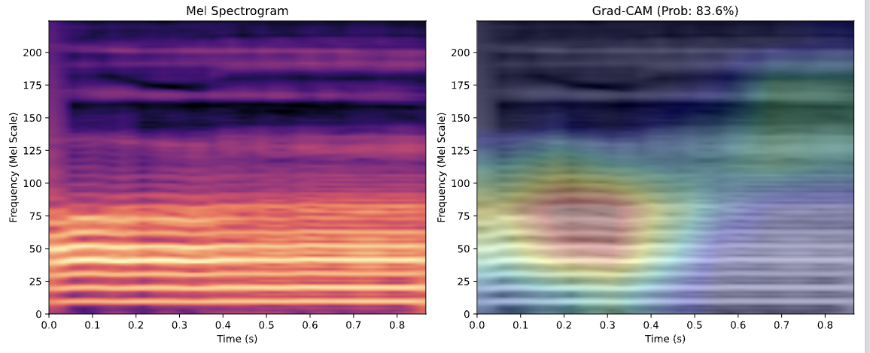
Inspiration (Project Week Applied Surgineering)
Deliverable:
PDF File for the ENT Doctor
(what the doctor sees in the report)

Slide 15
FOUR Parts for my Proposal 1. Explore other Parcellation Techniques 2. Improve Model + Explore SoTA Approaches 3. Explainability 4. Packaging in a UI Friendly Tool

Slide 16
Parcellation
Atlas-based
Going beyond the mean
Principal component extraction: Instead of mean, use first principal component of voxel time series within ROI to capture dominant signal pattern
ROI consistency weighting: Weight connections by ROI consistency to discount spurious links from heterogeneous regions
Homologous-Functional-Regions
Performing group-level functional image analyses based on homologous functional regions mapped in individuals
Deep Learning-Based Parcellation (OpenMAP‐T1)
Modern approaches use neural networks for rapid, accurate parcellation. OpenMAP-T1 integrates several CNN models across six phases: preprocessing, cropping, skull-stripping, parcellation, hemisphere segmentation, and final merging—parcellating the brain into 280 anatomical structures covering gray and white matter within minutes on a standard desktop.

Slide 17
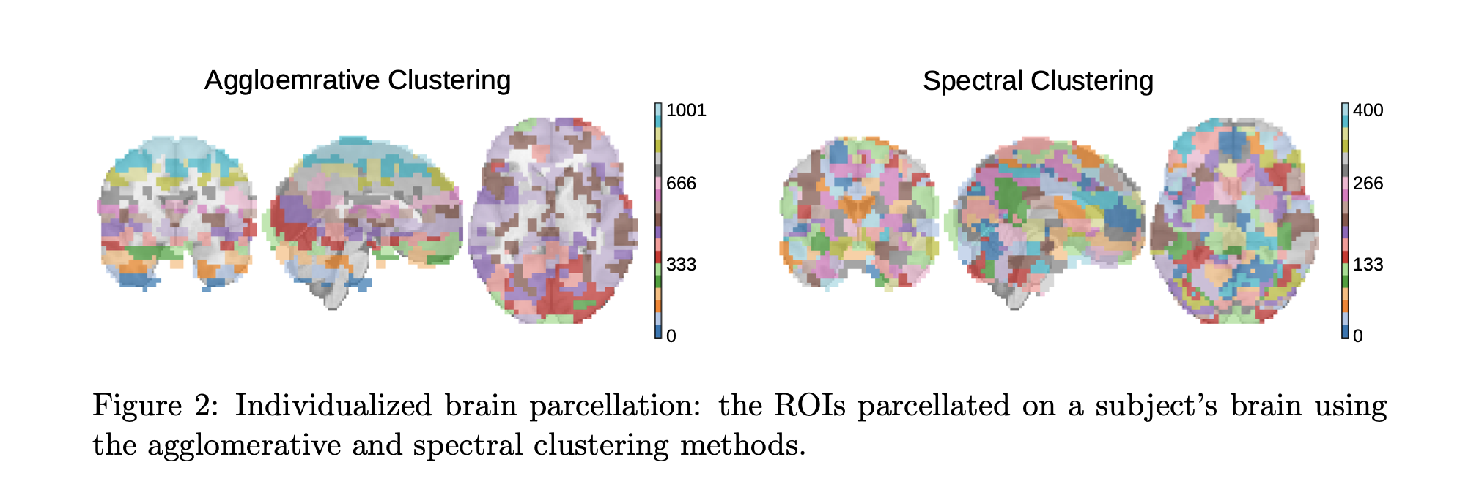
Parcellation
Individualized (Atlas-Free) Parcellation
Step 1:
Spatially-constrained Agglomerative Clustering: Works bottom-up, iteratively merging spatially adjacent voxels with high functional connectivity (Pearson correlation).
Spectral Clustering: Partitions voxels using the eigenspectrum of a similarity graph (the Pearson correlation matrix).
Atlas-free Brain Network Transformer
Notes:
Step 1:
Step 3:
The ROI-to-voxel connectivity vectors are:
Projected to lower dimensions via PCA
Organized into multi-channel brain maps in 3D space
Partitioned into overlapping 3D blocks
Processed through TRANSFORMER architecture (self-attention) to learn standardized representations​

Slide 18
Parcellation
Individualized (Atlas-Free) Parcellation
Step 1:
Spatially-constrained Agglomerative Clustering: Works bottom-up, iteratively merging spatially adjacent voxels with high functional connectivity (Pearson correlation).
Spectral Clustering: Partitions voxels using the eigenspectrum of a similarity graph (the Pearson correlation matrix).
Step 2: ROI-to-Voxel Connectivity
Since each subject's parcellation is unique, direct ROI-to-ROI comparisons across subjects become impossible.
Atlas-free methods solve this by computing connectivity in a standardized voxel-based feature space:​
This produces a high-dimensional feature vector for each ROI that can be compared across subjects
Notes:
Step 1:
Step 3:
The ROI-to-voxel connectivity vectors are:
Projected to lower dimensions via PCA
Organized into multi-channel brain maps in 3D space
Partitioned into overlapping 3D blocks
Processed through TRANSFORMER architecture (self-attention) to learn standardized representations​

Slide 19
Parcellation
Individualized (Atlas-Free) Parcellation
Step 1:
Spatially-constrained Agglomerative Clustering: Works bottom-up, iteratively merging spatially adjacent voxels with high functional connectivity (Pearson correlation).
Spectral Clustering: Partitions voxels using the eigenspectrum of a similarity graph (the Pearson correlation matrix).
Step 2: ROI-to-Voxel Connectivity
Since each subject's parcellation is unique, direct ROI-to-ROI comparisons across subjects become impossible.
Atlas-free methods solve this by computing connectivity in a standardized voxel-based feature space:​
This produces a high-dimensional feature vector for each ROI that can be compared across subjects
Step 3: Dimensionality Reduction and Feature Extraction (PCA + Transformers)
Notes:
Step 1:
Step 3:
The ROI-to-voxel connectivity vectors are:
Projected to lower dimensions via PCA
Organized into multi-channel brain maps in 3D space
Partitioned into overlapping 3D blocks
Processed through TRANSFORMER architecture (self-attention) to learn standardized representations​

Slide 20
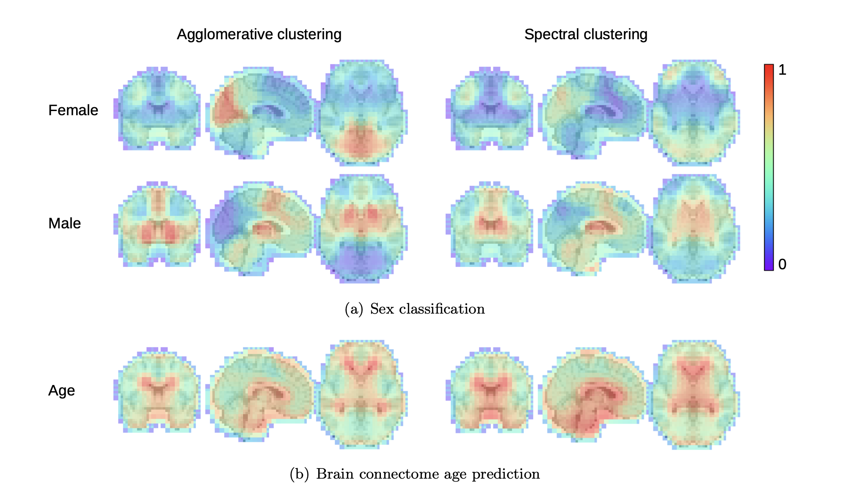
Atlas-free
→ Atlas-free BNT achieves 89.2% accuracy on sex classification compared to 87.9% for the best atlas-based method (BNT with Craddock-400).
For brain age prediction, atlas-free achieves MAE = 4.03 years vs 4.21 years for the best atlas-based approach
Atlas-free Brain Network Transformer

Slide 21
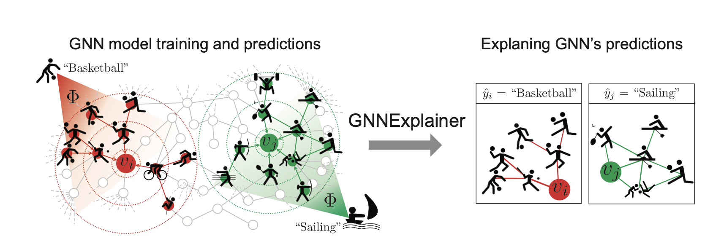
Diagnosis xAI
Extend GAAE
GNNExplainer: Generating Explanations for Graph Neural Networks
Notes:
Since we want to keep GNNs
GNNExplainer explains a prediction of a trained GNN by learning:
an edge mask (important subgraph), and
a feature mask (important feature dimensions), such that, using only the masked graph/features, the model’s output for that target stays almost the same.
--->Then GNNExplainer can tell you:
which neighboring nodes/edges most affect that reconstruction,
which input feature dimensions (of node ii and its neighbors) matter most.

Slide 22
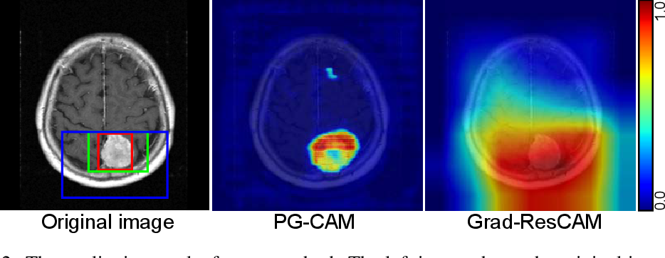
Diagnosis xAI
CNN + RNNs/LSTM + GradCAM
Robust Tumor Localization with Pyramid Grad-CAM

Slide 23
Diagnosis xAI
Transformer (Atlas-free Approach)
Robust Tumor Localization with Pyramid Grad-CAM

Slide 24
Focus: Find what works

Slide 25
Focus: Find what works Finetune

Slide 26
Focus: Find what works Finetune
Explain Results (in medical
Notes:
So I don’t want my focus just to improve the accuracy of a single model

Slide 27
Resting-state fMRI detects alterations in whole brain connectivity related to tumor biology in glioma patients

